Slide 1

Friendship Cities and
China New Zealand
Year of Tourism
2019
Mr. Hao Zhongwei
Deputy Director General of the Department of American and Oceanian Affairs
Chinese People's Association for Friendship with Foreign Countries (CPAFFC)

Slide 2

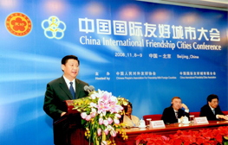
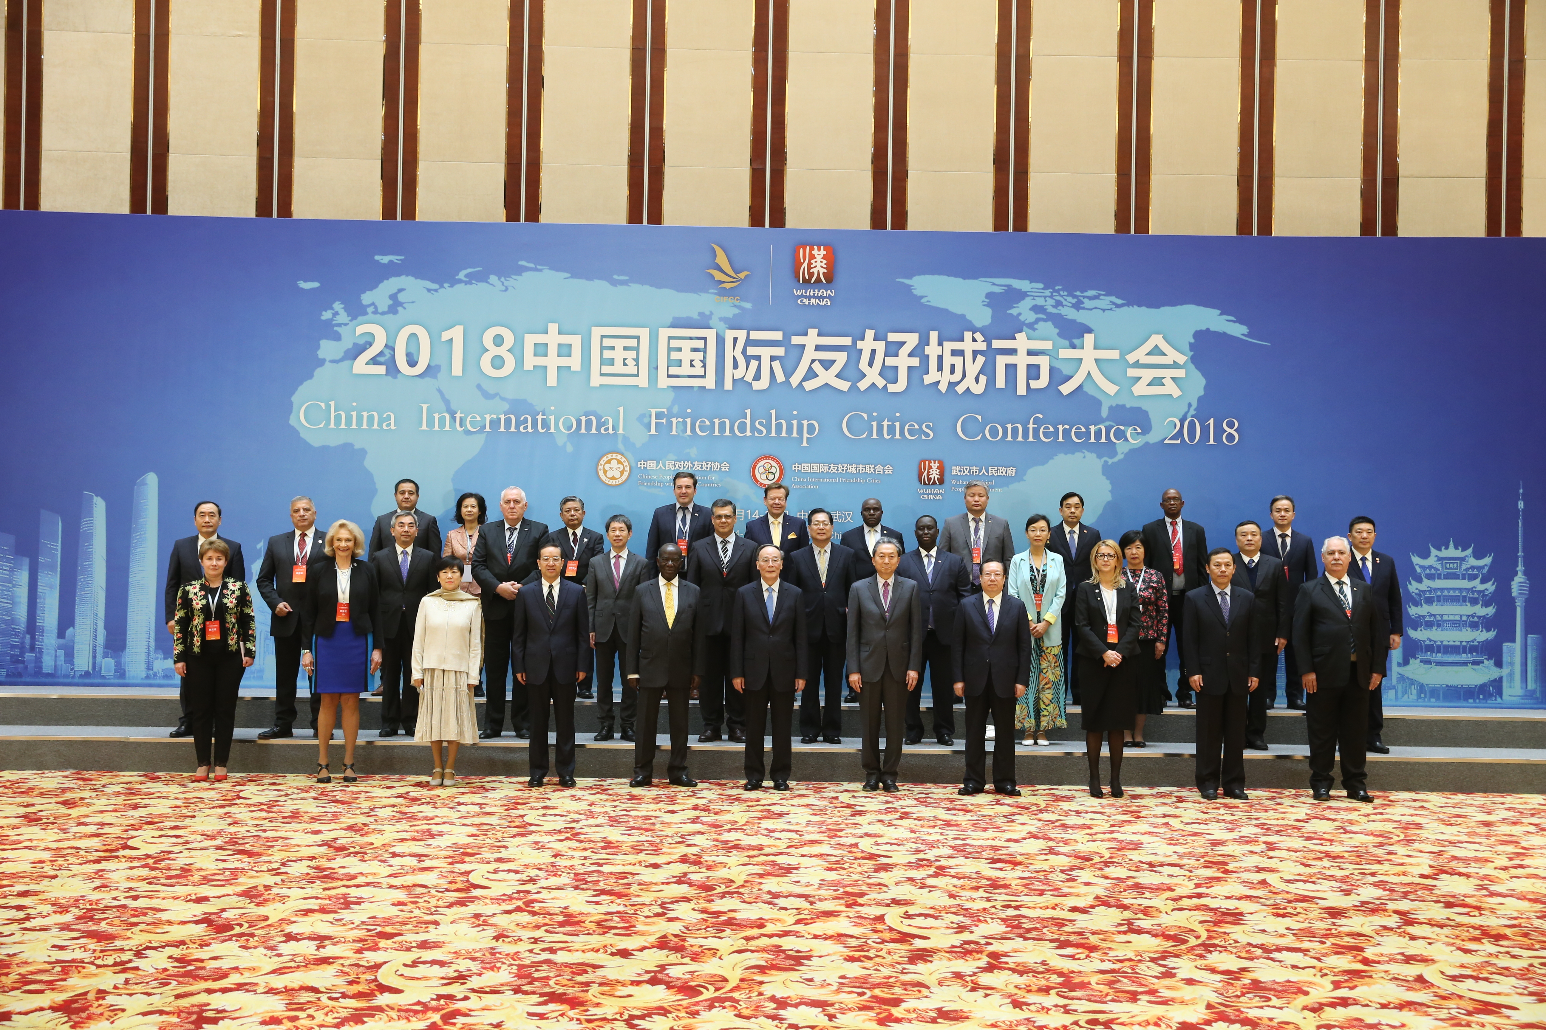

Friendship Cities
Management in China
Entrusted by the State Council, the CPAFFC began to take charge of managing Chinese friendship cities in 1992. China International Friendship Cities Conference has been held 6 times by CPAFFC until the end of 2018.

Slide 3
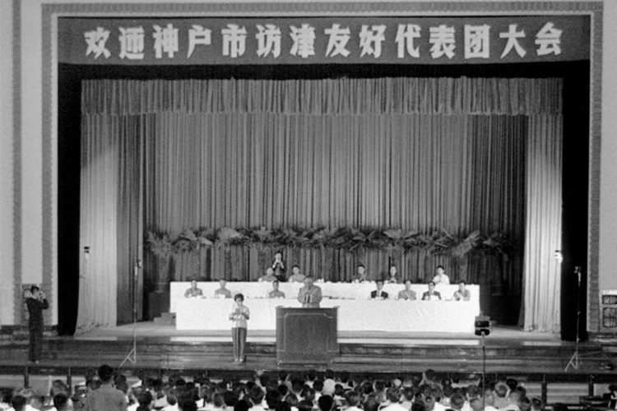
The First Pair of Friendship Cities
Tianjin and Kobe are twinned as friendship cities in June 1973. It is the first pair of friendship cities between China and other countries.

Slide 4
Up to Now......
China has by far established more than 2600 pairs of friendship-city/province relations with more than 136 countries.
A total of 38 pairs of friendship cities between China and New Zealand.

Slide 5
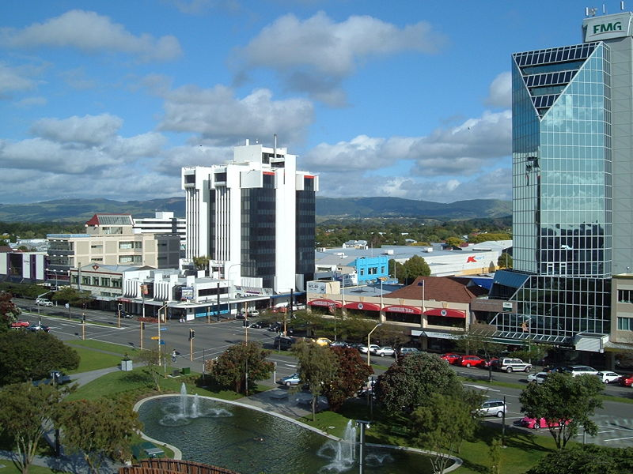

Guiyang & Palmerston North
●Palmerston North
Palmerston North established friendship-city relations with Guiyang, the capital city of Guizhou Province, a south-west province in China, in August 1992.
●Guiyang

Slide 6
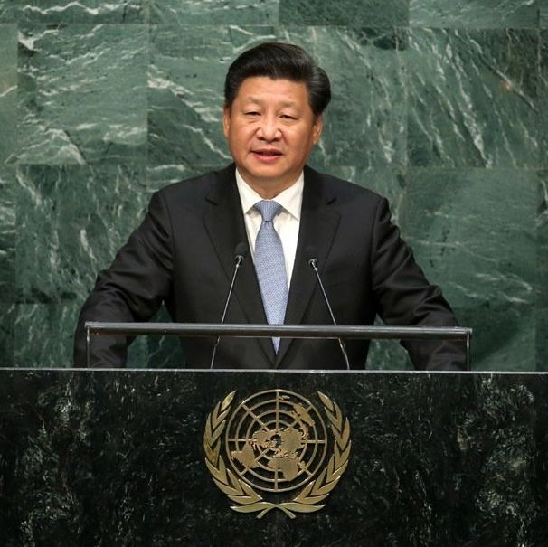
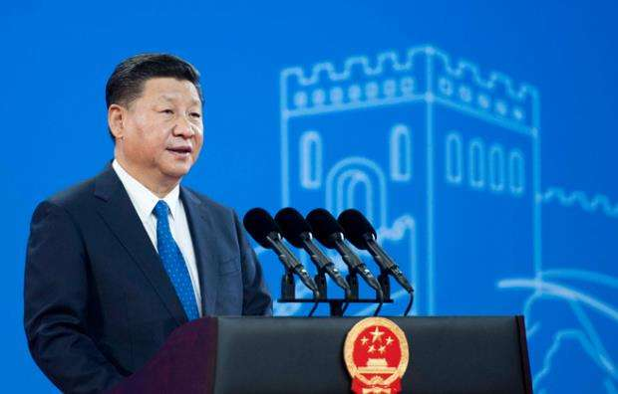

Prosperity through Partnership
China is an important force for promoting cooperation and common development.

Slide 7
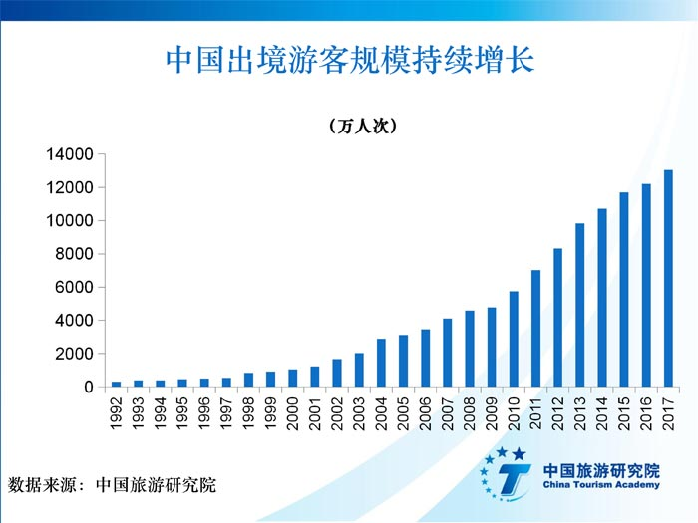
Continuous Growth of Outbound Tourism from China
The number of outbound tourists from China was 149.72 million in 2018, up by 14.7% over the previous year.
As of March, 2018, the total of foreign tourists to New Zealand in the past 12 months reached 3.82 million person times, among which 11% are from China, which ranked second only to Australia.
The number of outbound Chinese tourists from 1992 to 2017. (statistics from China Tourism Academy)

Slide 8
The countries that tourists are mostly satisfied with in 2017
Rank | Country
1 | Singapore
2 | New Zealand
3 | United States
4 | Germany
5 | Canada
6 | France
7 | Italy
8 | Australia
9 | UK
10 | Japan

Slide 9
Top 10 overseas destinations for Chinese tourists in 2017
Rank | Country
1 | Thailand
2 | Japan
3 | Vietnam
4 | Republic of Korea
5 | United States
6 | Malaysia
7 | Singapore
8 | Indonesia
9 | Russia
10 | Australia

Slide 10
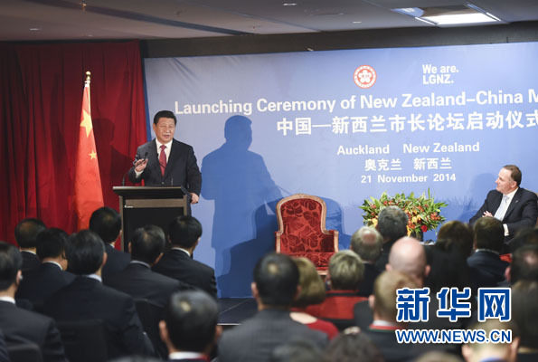
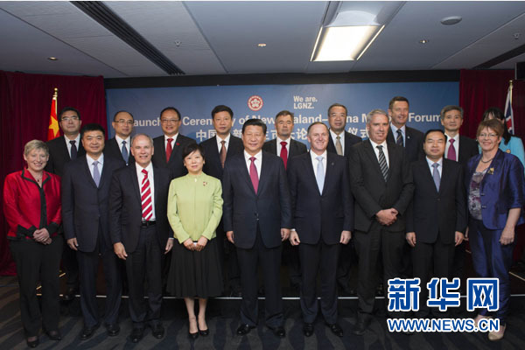
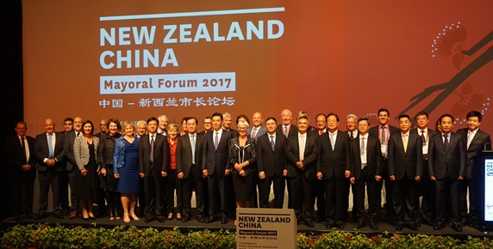
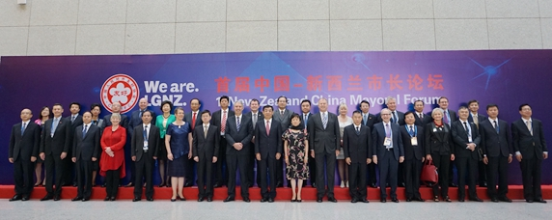
2020 New Zealand China Mayoral Forum
New Zealand-China Mayoral Forum will continue to promote resources sharing and complementary advantages between local governments of the two countries and promote the continuous healthy development of bilateral local relations.

Slide 11
Thank You

