Slide 1
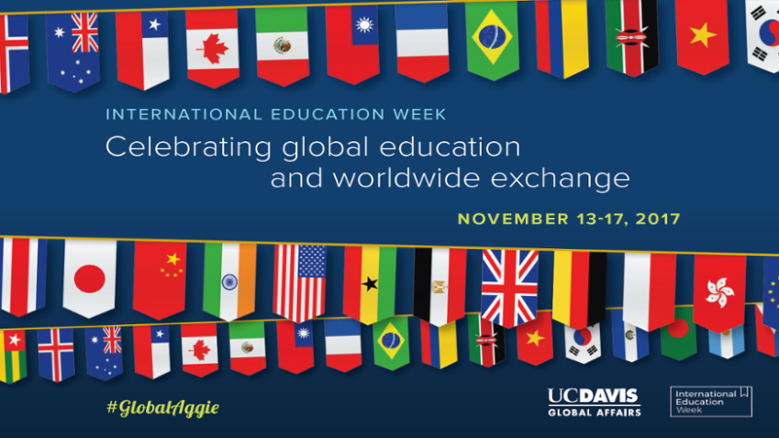


Collaboration
Through Intercultural Communication
The Missoula, Montana, Model
Providing an Interactive Window to the World

Slide 2
Global and Cultural Affairs
Global and Cultural Affairs is imbedded in Arts Missoula.
Arts Missoula (formerly Missoula Cultural Council) was formed in February 1991.
It is a non-profit 501(c)(3) organization.
It is an official cultural agency for Missoula County and the City of Missoula.

Slide 3
Global and Cultural Affairs
Arts Missoula strives for collaborative efforts between cultural organizations, public agencies, and the private business sector.
Arts Missoula has currently 5 employees.
Global and Cultural Affairs office opened May 1, 2018.

Slide 4
Services for Missoula
Global and Cultural Affairs
Services for
Sister City Partnership
Services for
City and
County Employees
Services for
MCPS
K-12
Services for
Missoula Community
Coordinate Emerging Global Leaders Exchange Program
CS Skill-Building
Seminars
For
K-12
Students
For
K-12
Teachers
Roxy
World
View FS
CS Skill-Building
Seminars
Develop and Assist
With Programming
Throughout The Year
CS Skill-Building Seminars
CS Teacher Academy
CS = Cultural Sensitivity

Slide 5
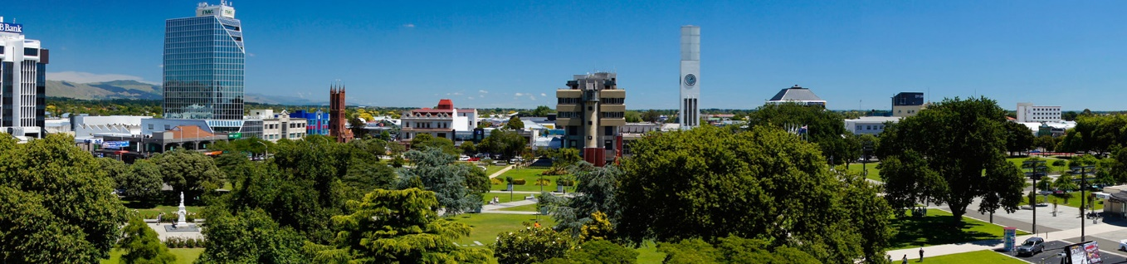
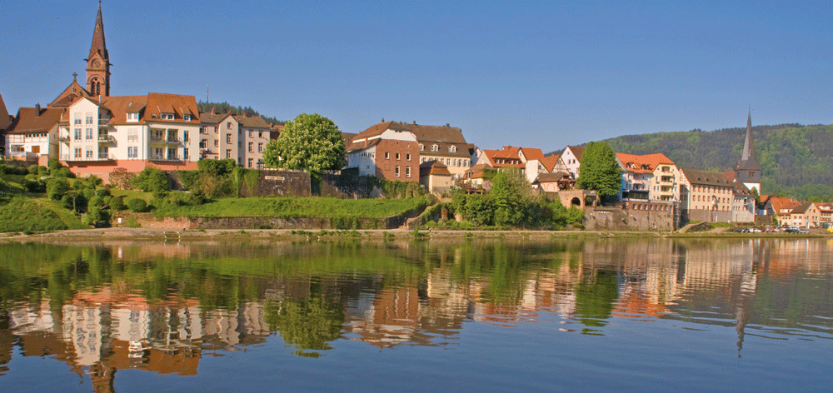

Services for Sister City Partnerships
Palmerston North, New Zealand
and
Neckargemünd, Germany

Slide 6
Sister City Partnerships
A Strategic Approach
Revamping of sister city exchanges were necessary.
Moving to a more Strategic City Partnership model.
Developed proposal for Culture and Language Immersion Program (CLIP)
Fosters cultural and language exchange and also offers exchange options for professionals.
Providing opportunities for Missoula citizens and city officials to participate in exchange programs.
Global and Cultural Affairs - Encouraging Cultural and Educational Exchanges 6

Slide 7
CLIP Offers Opportunities in Two Areas
CLIP-S Student Program for Emerging Global Leaders
  Youth Exchange Program for Culture, Language and Leadership Development
  Increase attractiveness to high school students
CLIP-PC for Professionals and Community Members
  Exchange program for adults
  Fostering professional development opportunities abroad for professionals and community members.
  Similar to the program for students, it focusses on strengthening culture, language and leadership skills.
Global and Cultural Affairs - Encouraging Cultural and Educational Exchanges 7

Slide 8
Services for City and County Employees

Slide 9
Services for City and County Employees
Developing and delivering intercultural sensitivity seminars
Providing trainings that help participants to become more culturally sensitive, aware, and understanding in interactions with others.
Reducing adjustment time of new employees, their co-workers, and managers.
Creating more positive working relationships.
Serving as an intercultural training resource.

Slide 10
Services for Missoula County Public Schools (Kindergarten -12th Grade)

Slide 11
Services for Missoula County Public Schools (K-12)
Infusing cultural and global content into existing curricula.
Offering innovative, tailor-made modules that connect to classroom learning goals.
Presenting culturally diverse viewpoints to learners.
Assisting with the cultural integration of diverse populations in classroom environments.

Slide 12
Intercultural Competence for Students
Schools 2018 - 2019
Collaborated with principals and teachers
Developed and offered over 170 seminars in:
Fall 2018:
  Lewis and Clark Elementary School 18
  Meadow Hill Middle School 24
  Hellgate High School 20
Spring 2019:
  Chief Charlo Elementary School 40
  Rattlesnake Elementary School 30
  CS Porter Middle School 33
  Hellgate High School 13
Global and Cultural Affairs - Promoting Intercultural Understanding in Classrooms 12

Slide 13
Professional Development for Teachers
Global and Cultural Affairs - Promoting Intercultural Understanding in Classrooms 13

Slide 14
Intercultural Competence Academy
Collaborating with School Leadership
Collaborating with MCPS to offer seminars for teachers.
Trainings focus on the areas of pedagogy and curriculum.
Aid instructors in developing a teaching strategy that supports the changing demographic in today’s classroom.
Assist educators in infusing their courses with intercultural and global perspectives.
Global and Cultural Affairs - Promoting Intercultural Understanding in Classrooms 14

Slide 15
Services for the Missoula Community

Slide 16
Services for the Missoula Community
Linking Missoula to the world and the world to Missoula
Sharing diverse cultures, traditions, customs and values.
Facilitating a variety of culturally engaging public events, evening presentations/seminars, celebrations and exhibits that foster mutual understanding and respect.
Building intercultural and global tolerance and understanding through various forms of art, produced by diverse artists.

Slide 17
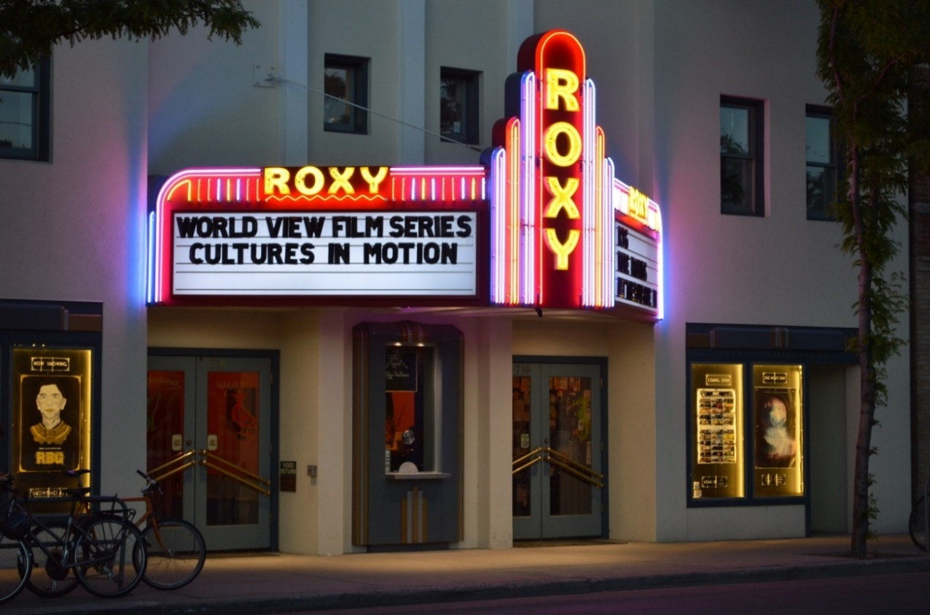
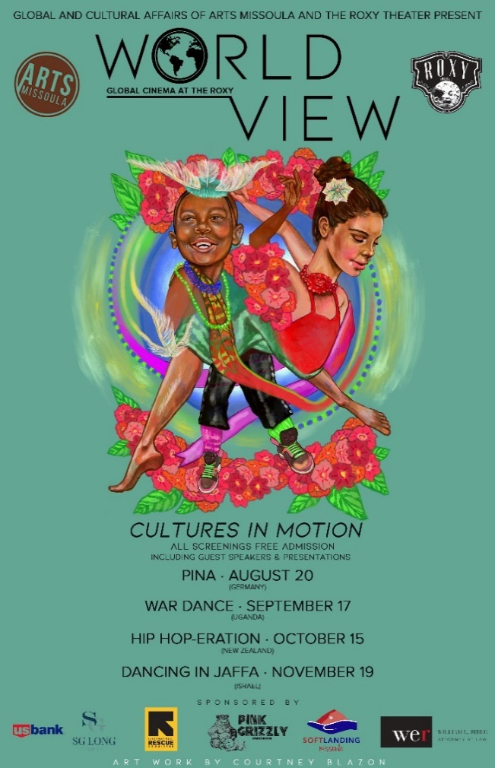
Roxy World View Film Series
Not just films, but cultural experiences
Made possible entirely through donations
Global and Cultural Affairs - Fostering Dialogue for an Inclusive Community 17

Slide 18
Collaborations
Global and Cultural Affairs proudly collaborates with the following organizations and offices:
Missoula County Public School
Inspired Classroom
Montana World Affairs Council
Montana Word Trade Center
International Rescue Committee
Soft Landing
Jeannette Ranking Peace Center

Slide 19

Collaborating with the
Global Engagement Office
  English Language Institute
The Payne Family Native American Center
Office of Academic Enrichment and Civic Engagement
Global and Cultural Affairs - Fostering Dialogue for an Inclusive Community 19

Slide 20
Training Structure
Global and Cultural Affairs - Fostering Dialogue for an Inclusive Community 20

Slide 21
AAC&U VALUE Rubric
Intercultural Knowledge and Competence
Definition: Intercultural Knowledge and Competencies are “ a set of cognitive, affective, and behavioral skills and characteristics that support effective and appropriate interaction in a variety of cultural contexts.” Milton Bennett, 2008
Knowledge – Cultural Self Awareness
Knowledge – Knowledge of Cultural Worldview Frameworks
Skills – Empathy
Skills – Verbal and Nonverbal Communication
Global and Cultural Affairs - Fostering Dialogue for an Inclusive Community 21

Slide 22
Moving from
Multicultural to Intercultural Communication
Global and Cultural Affairs - Fostering Dialogue for an Inclusive Community 22

Slide 23
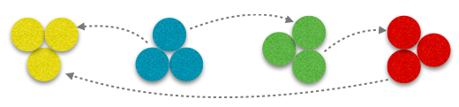
Visualizing Multicultural Communication
Global and Cultural Affairs - Fostering Dialogue for an Inclusive Community 23

Slide 24
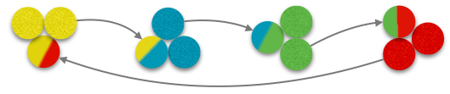
Visualizing Cross-Cultural Communication
Global and Cultural Affairs - Fostering Dialogue for an Inclusive Community 24

Slide 25
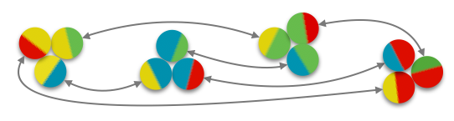
Visualizing Intercultural Communication
Global and Cultural Affairs - Fostering Dialogue for an Inclusive Community 25

Slide 26
How can we enhance our intercultural communication skills?
Global and Cultural Affairs - Fostering Dialogue for an Inclusive Community 26

Slide 27
The Intercultural Learning Process
Ethnocentrism
Awareness
Understanding
Acceptance/Respect
Appreciation/Valuing
Selective Adoption
Adaptation
Biculturalism
Multiculturalism
Global and Cultural Affairs - Fostering Dialogue for an Inclusive Community 27

Slide 28
Contact and Additional Information
For more information about programming, events, please visit:
Web: www.artsmissoula.org/global-cultural-affairs
For questions and follow-up, please contact:
Dr. Udo Fluck
Director, Global and Cultural Affairs
Mail: globalandculturalaffairs@artsmissoula.org
Web: www.artsmissoula.org/global-cultural-affairs
PO Box 7662
Missoula, MT 59807
Phone: 406.541.0860
Global and Cultural Affairs - Fostering Dialogue for an Inclusive Community 28

Slide 29
Q and A
Global and Cultural Affairs - Fostering Dialogue for an Inclusive Community 29

Slide 30
Thank You for your
Interest
Global and Cultural Affairs - Fostering Dialogue for an Inclusive Community 30

