Slide 1
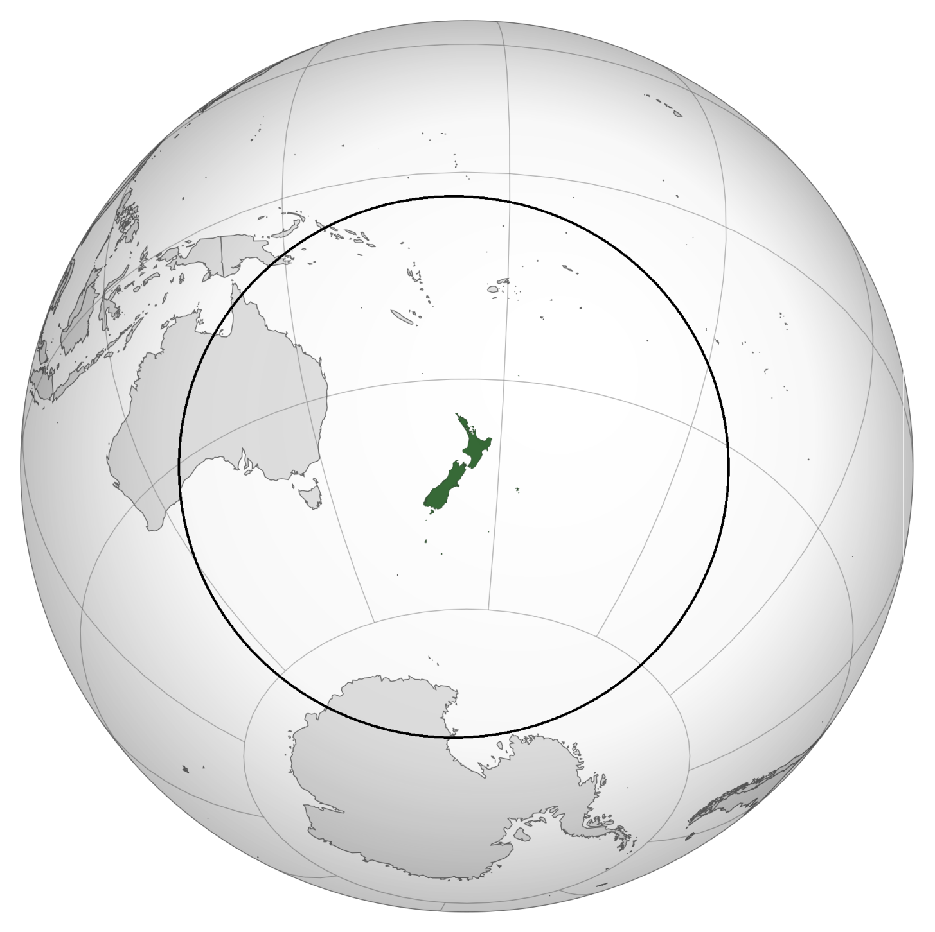
Within 5,000 km of New Zealand
Notes:
About 18% of NZ trade within 5,000 km (goods + services, exports + imports). About 14% of goods trade within 5,000km.

Slide 2
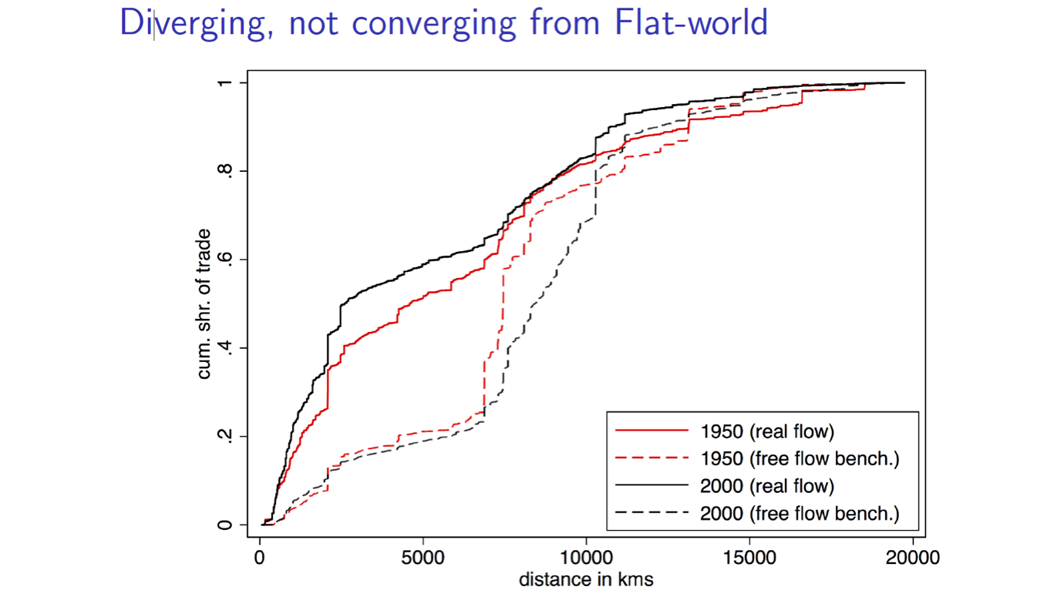
Distance effect on trade
Source: Keith Head and Thierry Mayer (2013)
Notes:
Distance is the single biggest barrier to NZ trade with the rest of the world.
Small economy emphasises the need for international trade. 20 odd cities in China with greater population than NZ
Tyranny of distance not improving.
Flat world = Pangaea

Slide 3
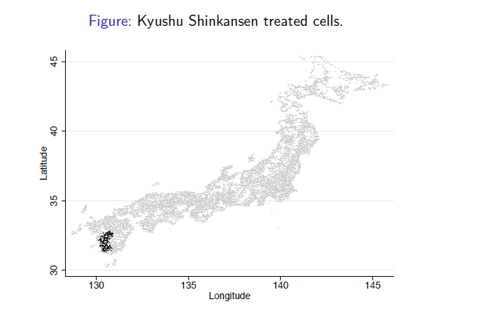
Buyers, sellers and productivity
Source: Bernard, Maxnes and Saito (2018)
Notes:
A quasi-natural experiment in Japan
A reduction in search costs.
Firms find new suppliers in areas with new stations.
The effects are strongest in industries with many purchased inputs.
Affected firms increase sales and productivity.

