Slide 1

Strategy to Action
Sister Cities New Zealand Conference
22 March 2019

Slide 2

Reno
https://www.dailymotion.com/video/x6hjud2
Notes:
At 1.15 mins on clip

Slide 3
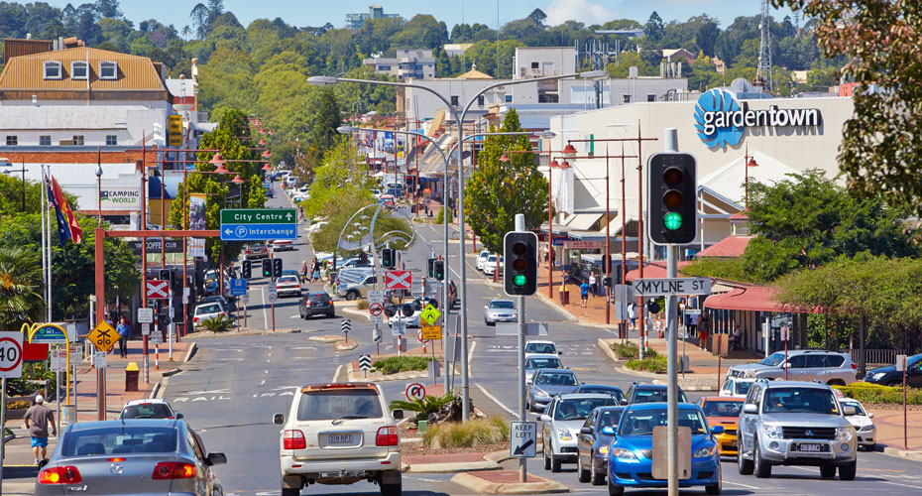
Toowoomba

Slide 4
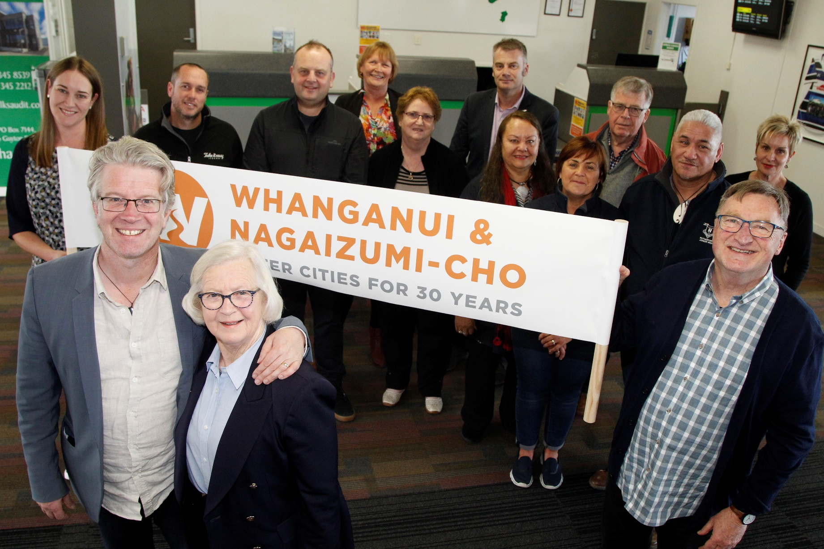
Nagaizumi-cho

Slide 5
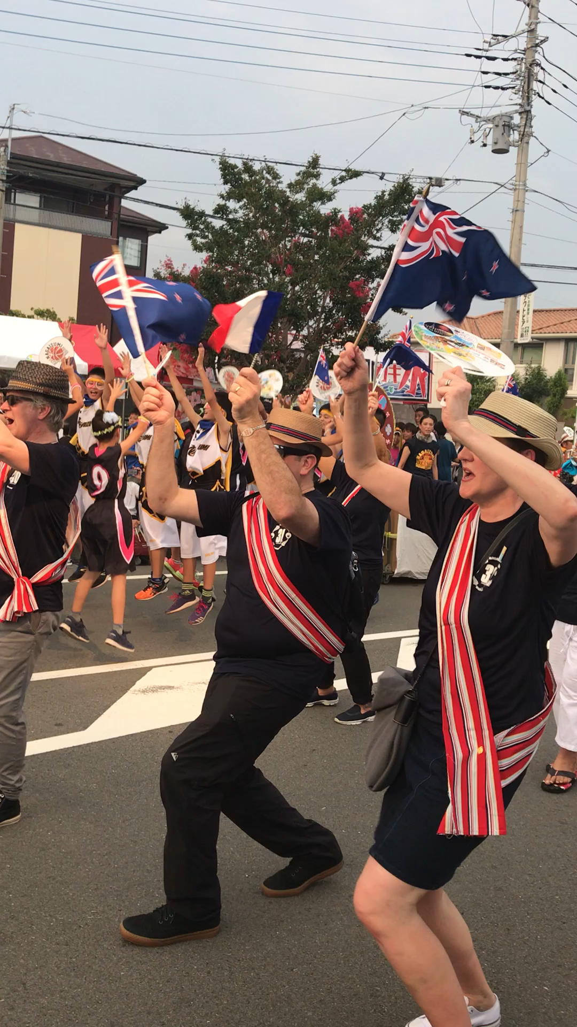
Nagaizumi-cho

Slide 6
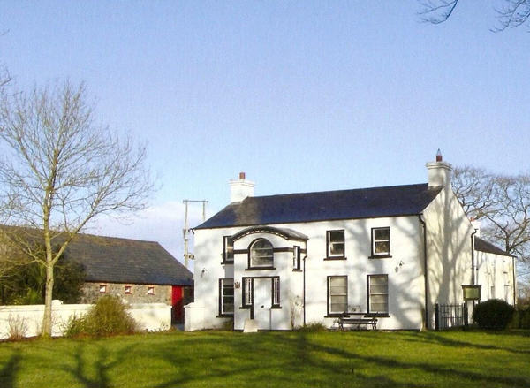
Lisburn

Slide 7

WDC International Relations Strategy

Slide 8
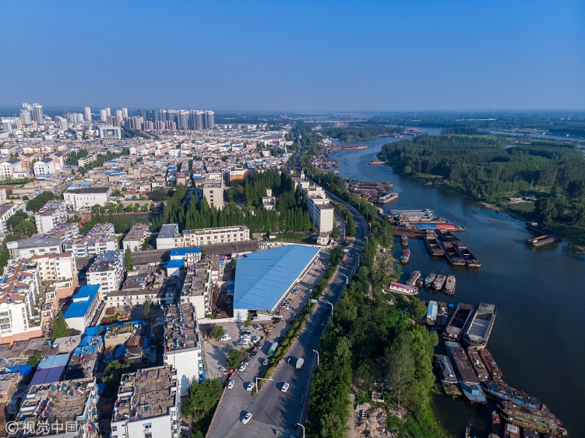
Xuzhou

Slide 9
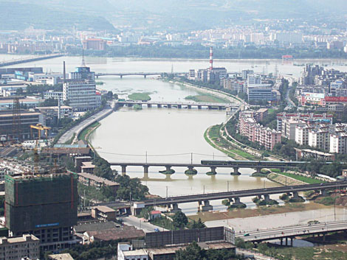
Baoji

Slide 10
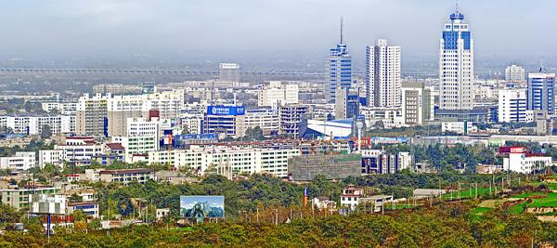
Weinan

Slide 11

Near Guangzhou

Slide 12
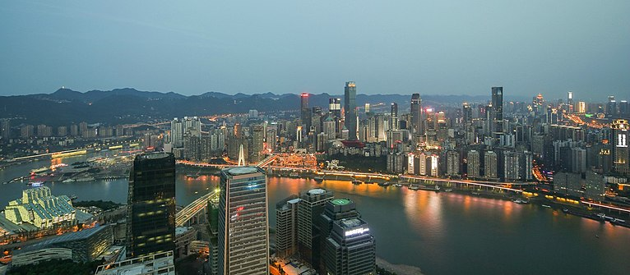
Chongqing

Slide 13

Leshan

Slide 14
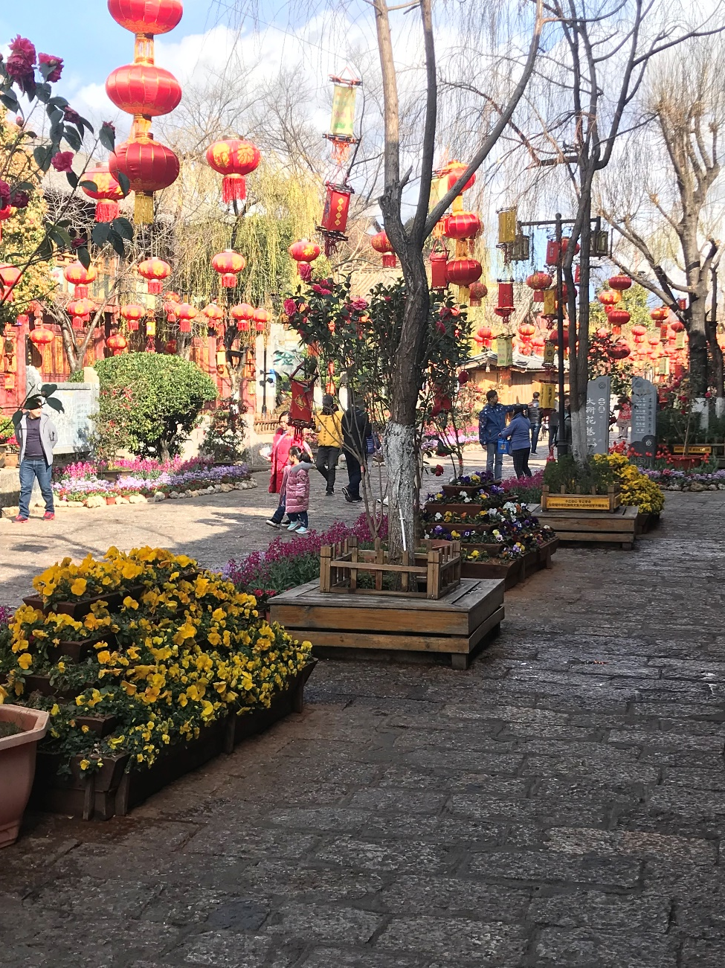

Lijiang

Slide 15
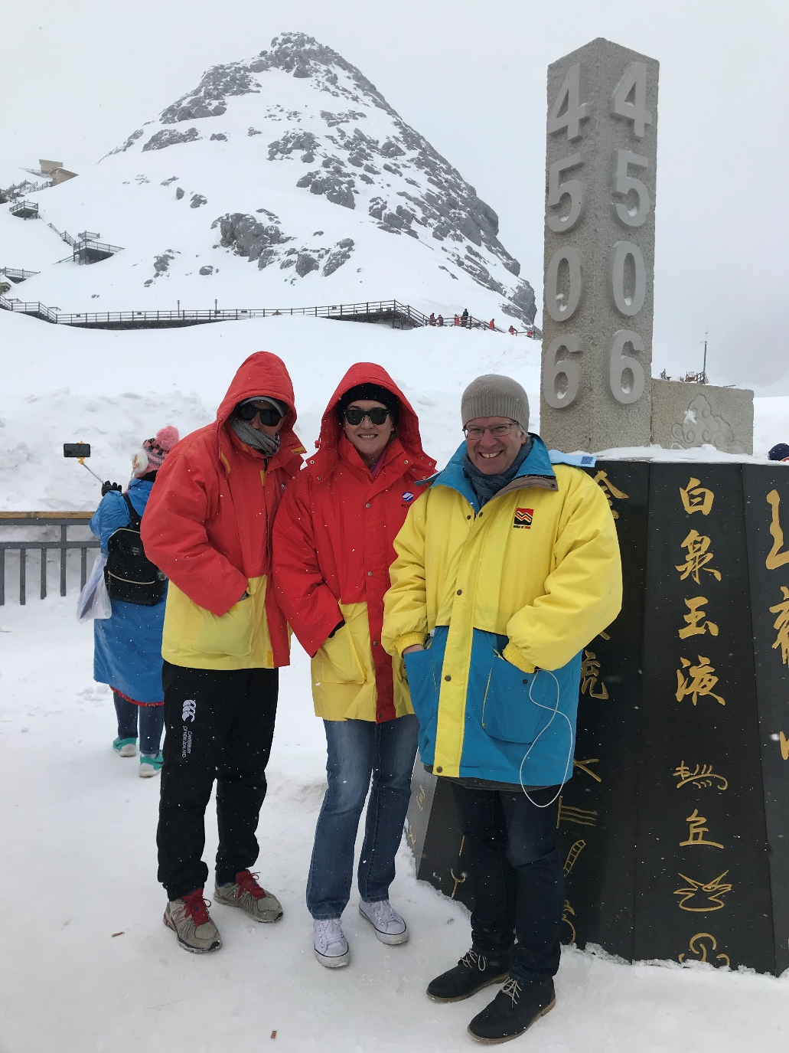
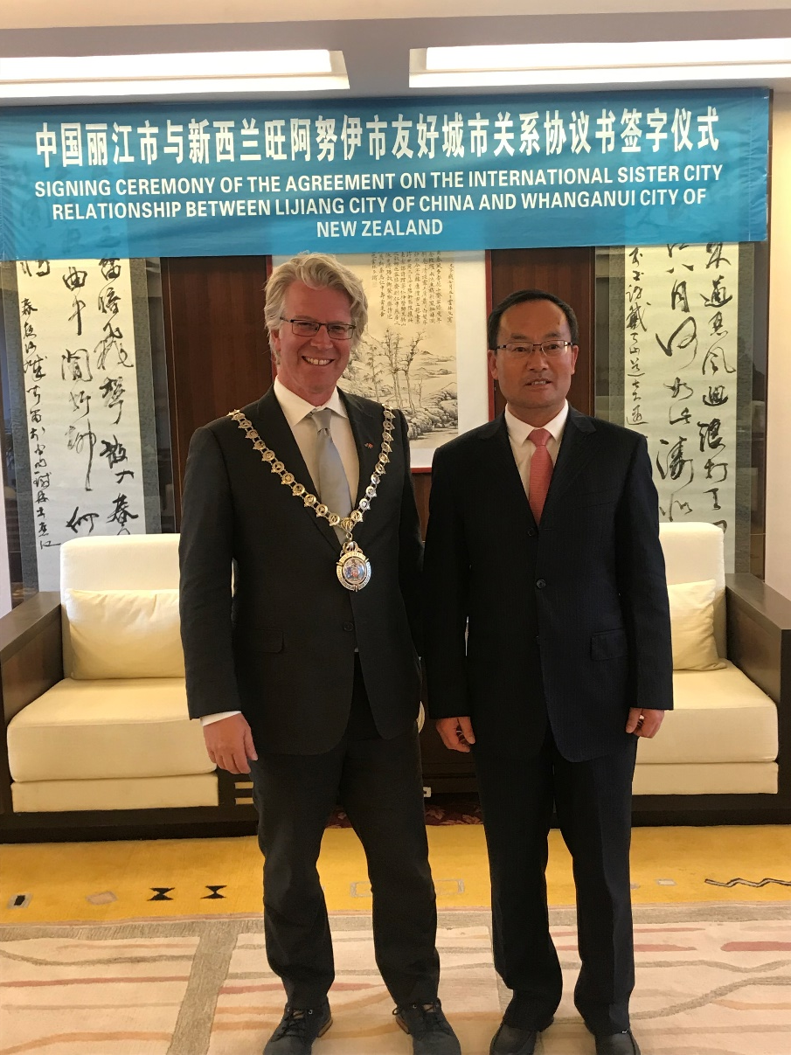
Lijiang

