Slide 1
WE
PRESENT.
New Zealand China Mayoral Forum

Slide 2


LGNZ Update
Presentation to Sister Cities Conference 2019
Philip Shackleton
Principal Policy Advisor
21 March 2019

Slide 3
1
Background

Slide 4
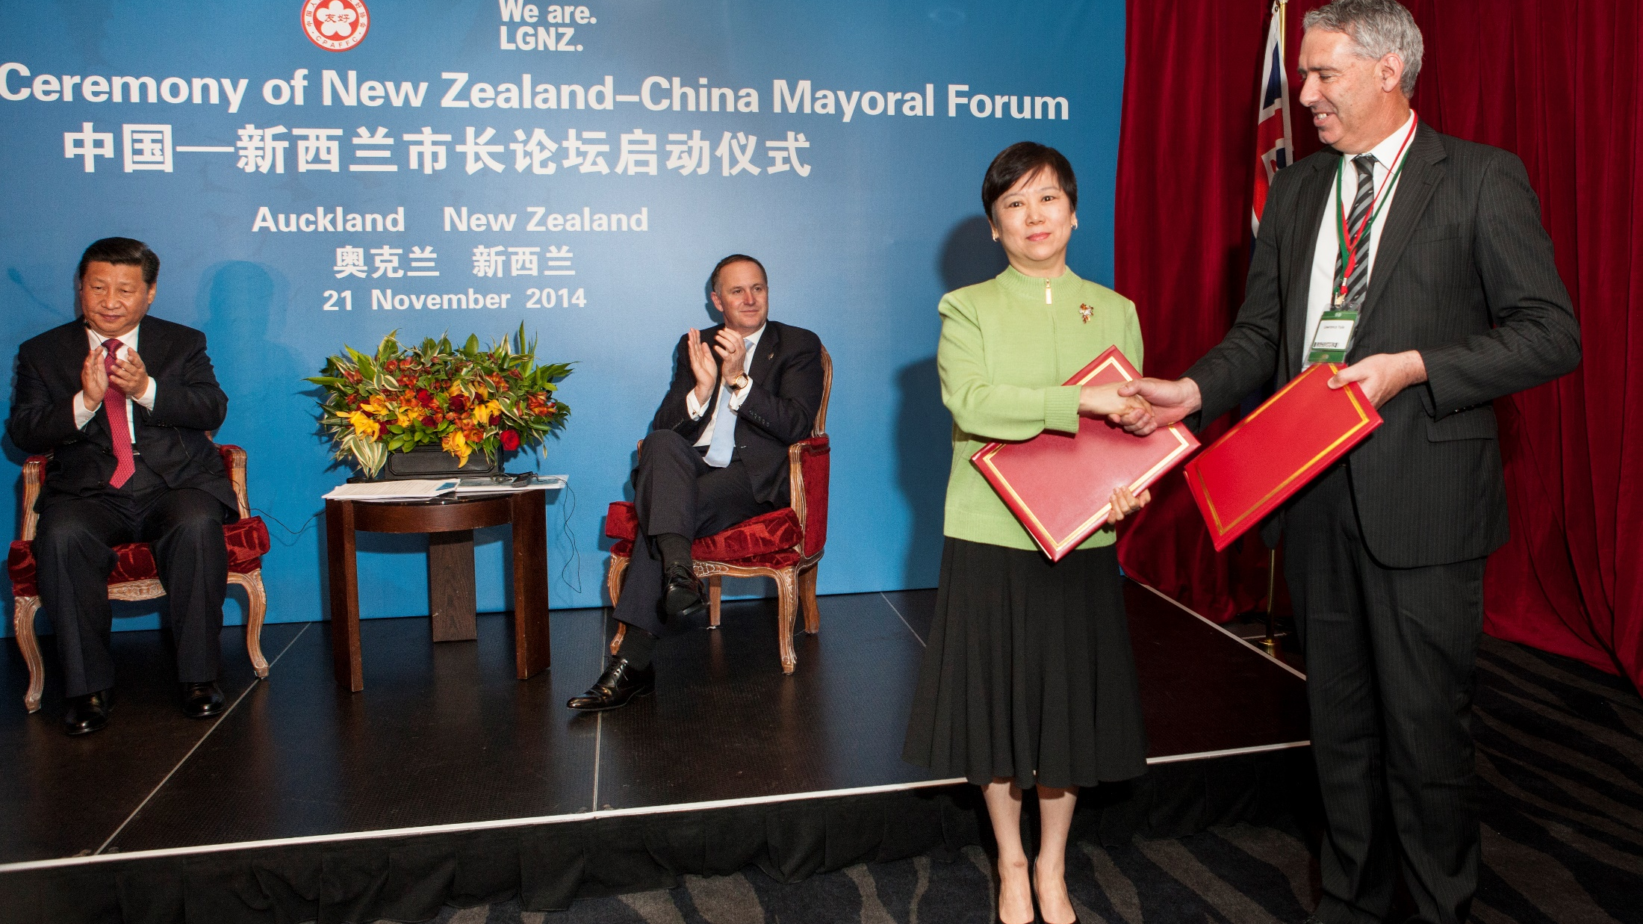

Slide 5
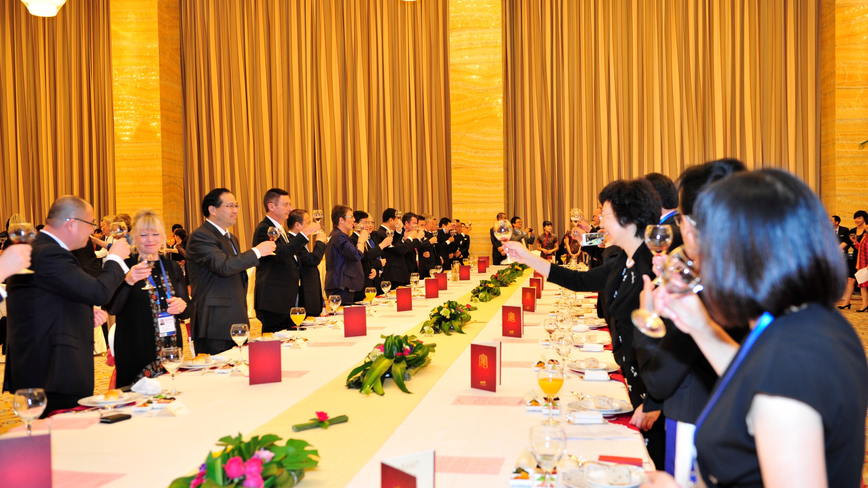
20 mayors from China
Guangzhou, Shenzhen, Xiamen, Guiyang, Qingdao, Weinan and Wuhan have attended multiple Forums.
38 mayors from New Zealand
Auckland, Christchurch, Dunedin, Gisborne, Hamilton City, Hastings, Matamata-Piako, Palmerston North, Taupo, Tauranga, Wellington and Whanganui have attended multiple Forums.

Slide 6
2
NZCMF 2020

Slide 7
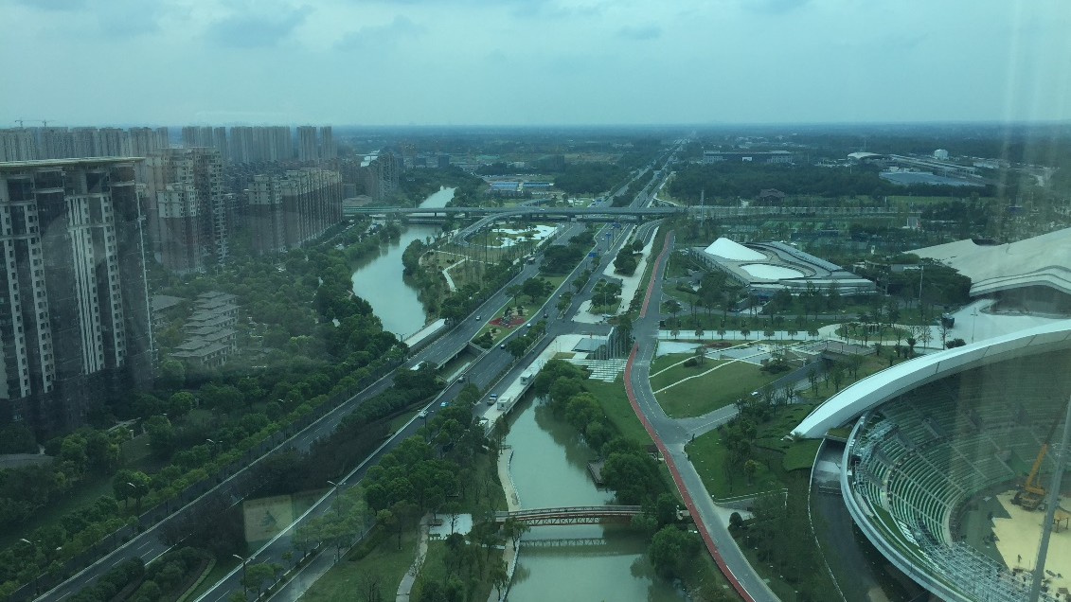
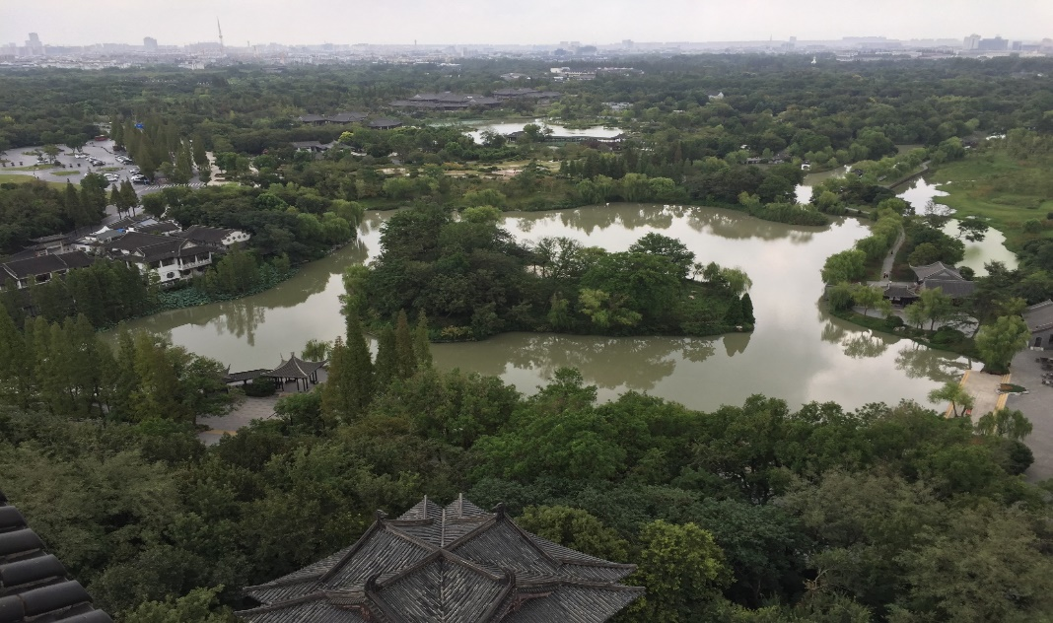
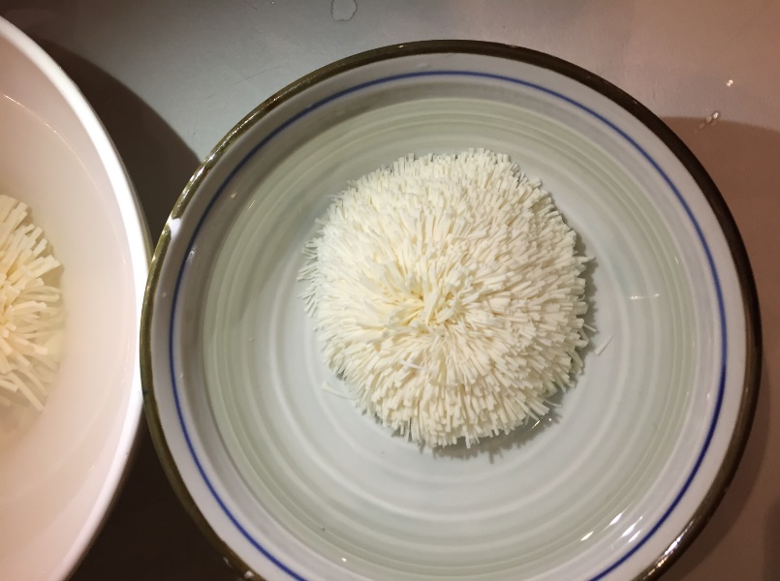
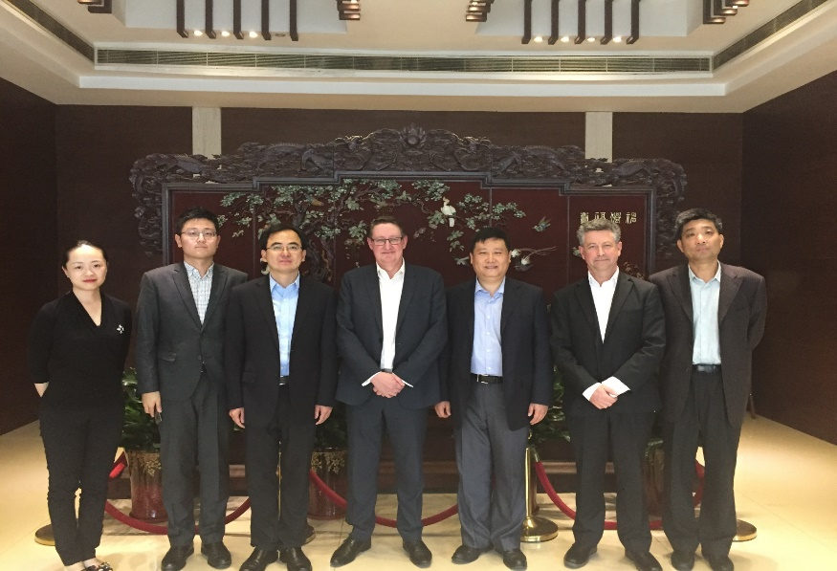
Yangzhou

Slide 8
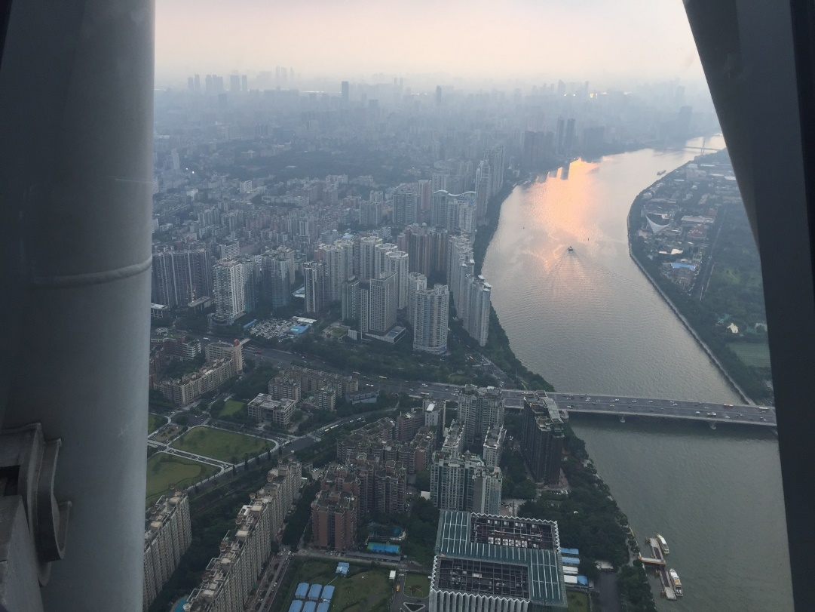
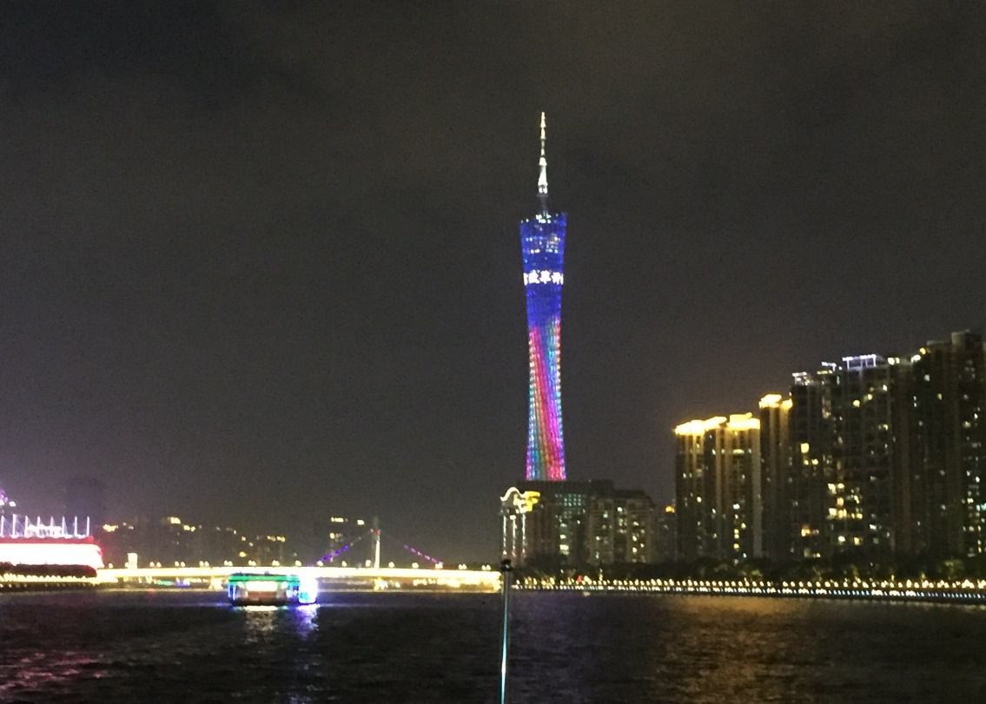
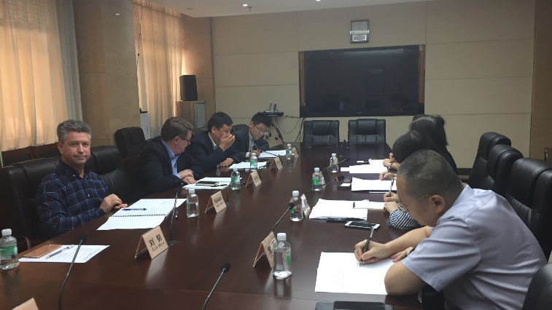
Guangzhou

Slide 9
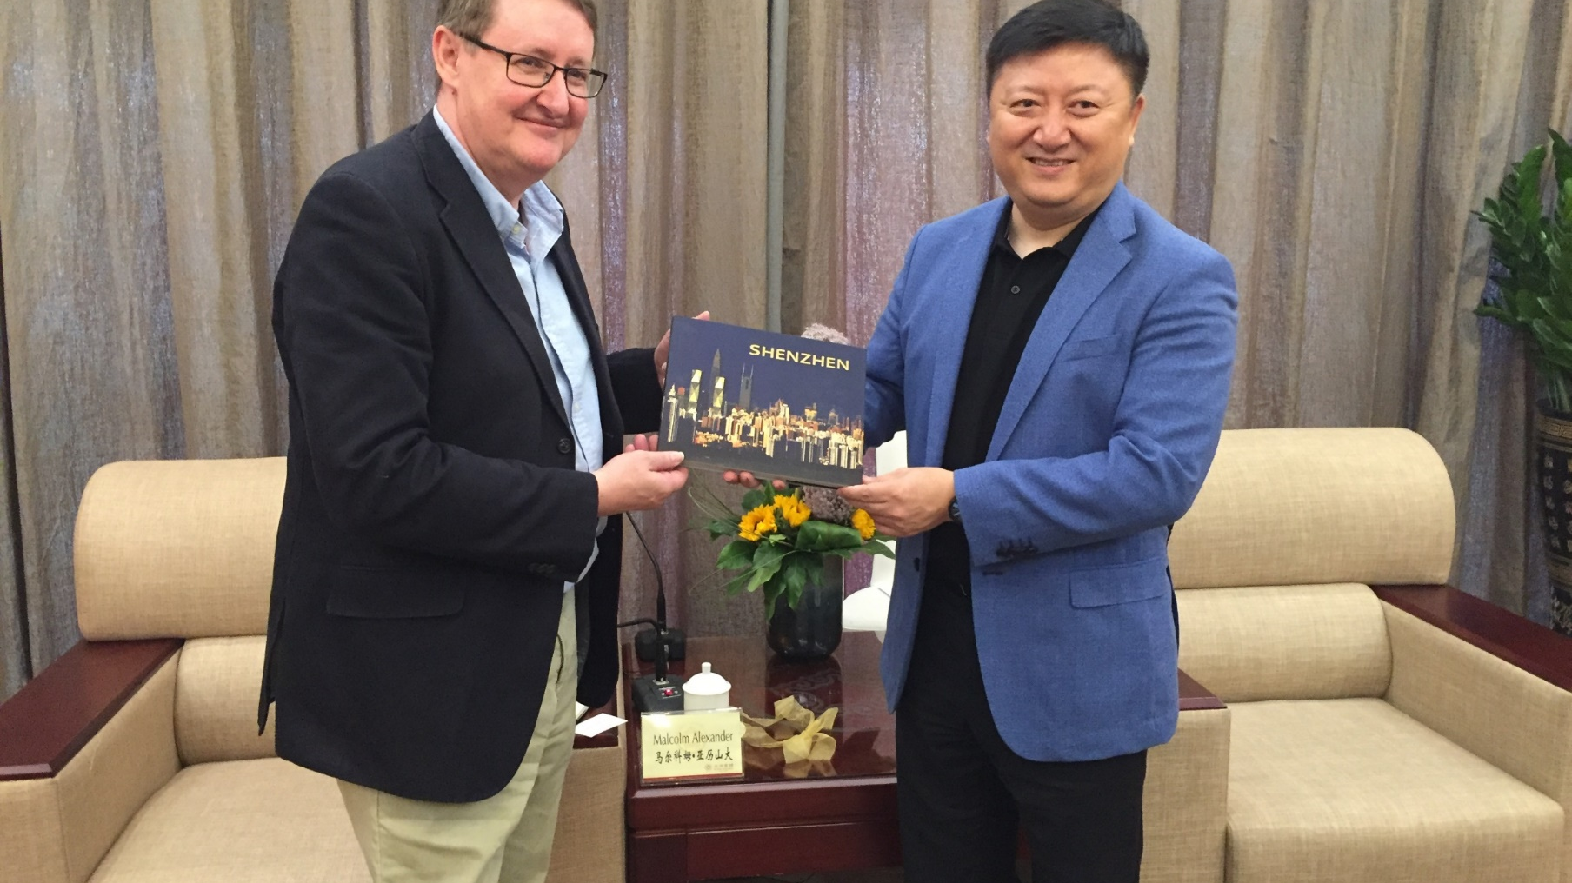
Shenzhen

Slide 10
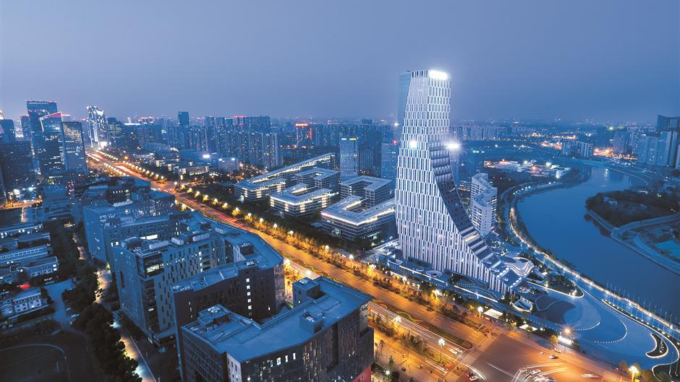
Chengdu

Slide 11
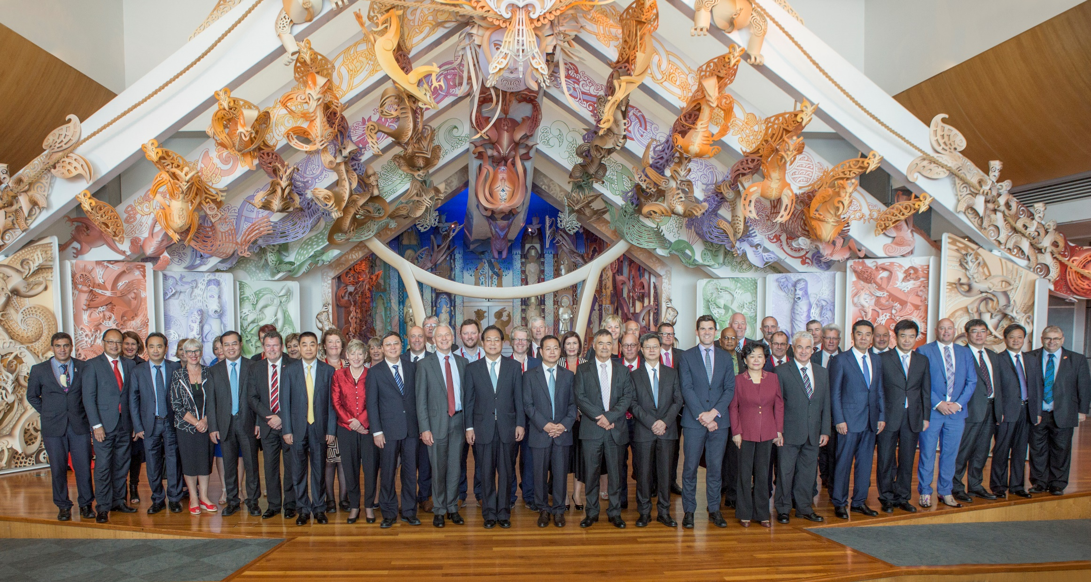

Slide 12


